Slide 1
Better Popovers can be just a keystroke away…
Fun with a popover

Slide 2
Setting up the popover
The first item on the agenda was how to display the portal row in the popover that’s outside the portal. This was easy as I already had a relationship…
This is my standard method for creating related records.

Slide 3
Launching the Popover
Next I needed a list of Record IDs from the portal to step through. The button to trigger the edit is in the portal row so the script was pretty easy…
Capture the Portal Row
Setup a list of IDs
Get the value of the portal row clicked.

Slide 4
Step right up (or down as the case may be)

Slide 5
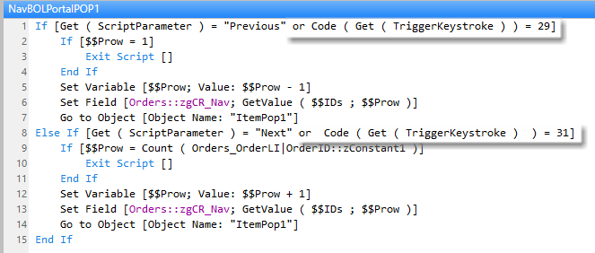
Step right up (or down as the case may be)
Capture the keystroke

Slide 6
Code() & Get (TriggerKeystroke)
Code - Returns the Unicode code points for the characters in text
up arrow = 29
down arrow = 31
Get ( TriggerKeystroke )
Returns the characters that activated an OnObjectKeystroke or OnLayoutKeystroke script
So we wrap it as so Code ( Get ( TriggerKeystroke ) ) = XX

Slide 7
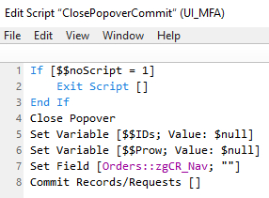
Closing the Popover
When the popover closes we need to clean up…
Clear Variables and the CR_Nav global

Slide 8
OnObjectKeystroke

Slide 9
For Data Entry
When using the popover for data entry we need an option to…
Print the Barcode label

Slide 10
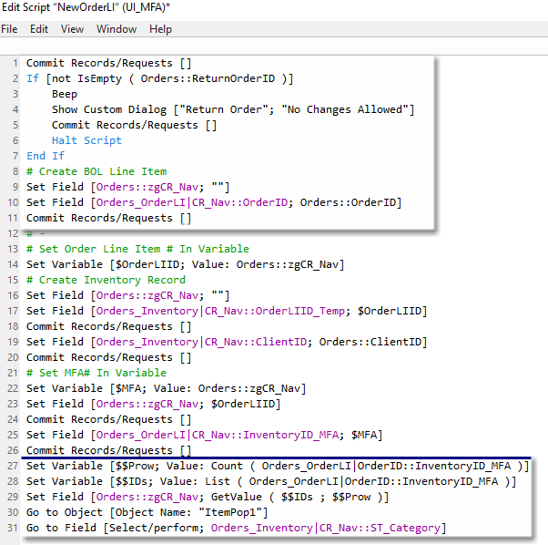
For Data Entry
Create new entry

